Slide 1
3. Module-in-a-Box: The Pandemic, Data Ethics and Visualization.
For reference, the first module considers Data Ethics, from the perspective of AI Blindspots & Data Preparation and the second module considers Data Privacy and Analysis.
Unislawa Williams, PhD
Associate Professor, Spelman College
XSEDE/SURA Data Science Fellow

Slide 2
Data Ethics Competency: Privacy*
Student Learning Outcomes (SLO): Demonstrate awareness and begin to evaluate Big Tech AI Principles.
Discussion Point: What is the role of Big Tech AI Principles?
AI at Google: Our Principles https://www.blog.google/technology/ai/ai-principles/
Microsoft AI: Responsible AI https://www.microsoft.com/en-us/ai/responsible-ai?activetab=pivot1%3aprimaryr6
Facebook AI: Facebook’s Five Pillars of Responsible AI https://ai.facebook.com/blog/facebooks-five-pillars-of-responsible-ai/
Homework: Data’s Ethical Component
The advantages of teaching data ethics along with data science is that the two subjects become well integrated.

Slide 3
Data Science Competency: Data Visualization*
Student Learning Outcomes (SLO):
“Demonstrate [some] ability to visualize data and extract insights (IBM Analytics, 7).” Homework
Discussion Point: Is data visualization just about insight sharing? Can data visualization help with analysis?
*IBM Analytics. “The Data Science Skills Competency Model: A Blueprint for the Growing Data Scientist Profession.” International Business Machines (IBM) Corporation. www.ibm.com/downloads/cas/7109RLQM

Slide 4
XSEDE Data Driven Competencies*
Student Learning Outcomes (SLO):
Students will [begin to] create a conceptual model: Define SciVis needs; Relationships to human visualization; Basic techniques:*
Homework
*Quoted from HPC University Educators. “Computational and Data Science Education Competencies.” http://hpcuniversity.org/educators/competencies/

Slide 5
Guide to Using this Module-in-the-Box in the Classroom
Slides with the Blue/Gray Formatting – Many of the slides in this module can be directly shared with students. To help the instructor sift through the materials these slides have blue formatting and blue title banners.
Slides with the Yellow/Orange Formatting –To help the instructor navigate some of the potential pitfalls, slides with orange formatting add additional background material and ease instructor preparation prior to teaching. Typically, R training has long start-up period. The approach used in this module for teaching R aims to speed up the process.

Slide 6
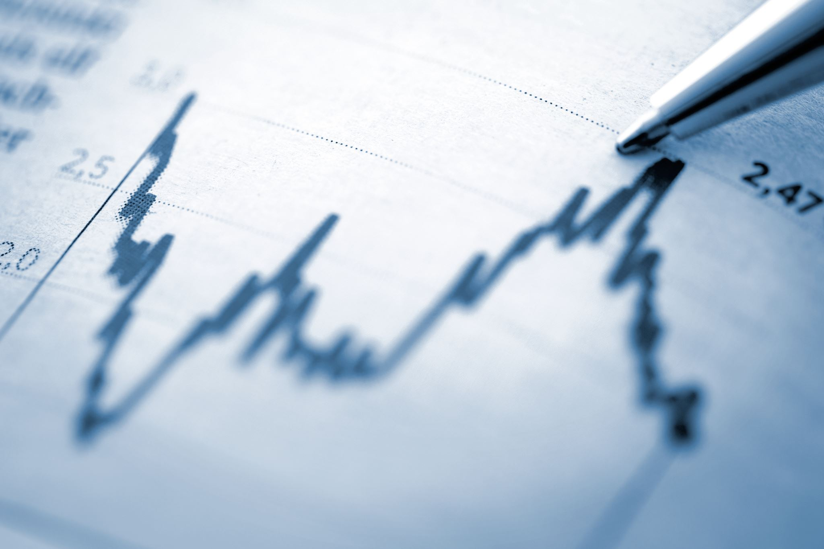
Assignments to be Completed in this Module:
HOMEWORK: You can utilize the R code/program from the Class Exercise. You do not have to understand every symbol in each of the commands. The code is largely provided for you so you can focus on adopting it. Focus on accurately reproducing the code in R and critically examine the R output (what the code produces). Advanced level homework is provided for those with previous programming experience.
CLASS EXERCISES: Although your work is not graded on these exercises, paying careful attention to this content is essential. The R code and materials from the class exercises will help you complete the graded homework assignment.

Slide 7
Class Exercise:
Google Trends/Ngrams’ visualizations
To get started, let’s go to https://trends.google.com/trends/ to explore terms related to the pandemic.
In addition to searching for the word “pandemic,” consider other related terms. Pay close attention to how the data is visualized.
What do the visualizations say about the trends over time and geographically? How is the trending topic different from the top result?
What would you communicate about the visualized results? Consider your audience and the intent of the analysis.
For a longer-term perspective, let’s go to https://books.google.com/ngrams to explore terms related to the pandemic.
In addition to searching for the word “pandemic,” consider other related terms. Pay close attention to how the data is visualized.
What do the visualizations say about the trends over time? How is the trending topic different from the results in published books?
What would you communicate about the visualized results? Consider your audience and the intent of the analysis.

Slide 8
Good Visualizations…
Following are some resources to help you answer your questions about visualizations:
Table or a Figure? https://writingcenter.unc.edu/tips-and-tools/figures-and-charts/
What’s considered good practice? https://porg/doi/10.1021/acsenergylett.1c00415,ubs.acs. https://pubs.acs.org/doi/10.1021/jz500997e
Do you have any amazing examples? https://visme.co/blog/best-data-visualizations/.
tell a good story
with help of a narrative
Watch the following video to help you build a good narrative https://hbr.org/video/6069960867001/storytelling-with-data-a-good-charts-workbook-tool
awareness of the audience
The following link discusses the audience https://hbr.org/2013/04/the-three-elements-of-successf
and the use of clear labels
The following video shows how clear labels (titles, legends, units) can clarify and highlight the story https://www.youtube.com/watch?v=5Zg-C8AAIGg

Slide 9
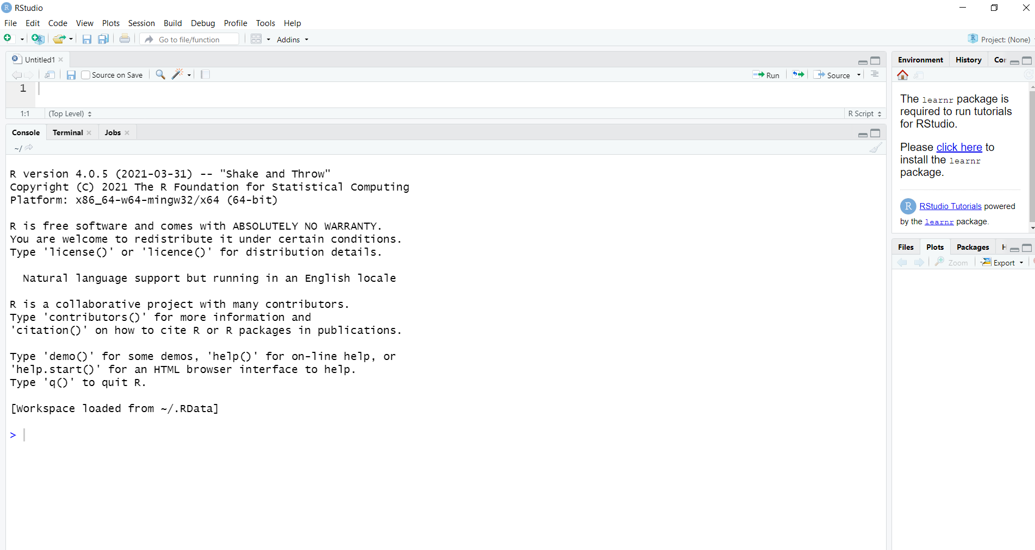
The role of R in data science includes data visualization:
R & RStudio
look like this
> (prompt) is where you input the code & press enter. R will generate output. If you receive an error (very common), check the spelling first.
R is a free statistical software used to perform many of the data science tasks.
Other popular data science tools, include Python, Tableau, and many other tools some of which are even discipline or task specific.
The versatility of R, makes it a good tool to learn.
Following are some simple ways to use R right away in a class exercise. We have included these hands-on exercises to help you practice the material. Throughout this training module, class exercises will provide hands-on experience showcasing Rs benefits for data modeling.

Slide 10
Access and R
To really be able to run R students may need to install it on their own laptops. The following slide offers instructions on how to install R on your own machine.
However, access issues often arise. And some students may be unable or unwilling to install R on their own, usually for a good reason.
One way to get around access issues is via advanced computing resources, such as XSEDE.

Slide 11
How to install R and RStudio on your home computer
Here are the steps to install R:
First, please go to: https://cran.r-project.org/ and you will see the following:
Download R for Linux
Download R for (Mac) OS X
Download R for Windows
Follow the instructions for Windows or Mac, depending on your machine.
Second, you will see a link that says install R for the first time. Follow the link to the next page.
Third, you are ready to download R by clicking the Download link.
Fourth, the installer will walk you through the rest of the download.
You also need RStudio. RStudio makes using R more manageable:
First, please go to: https://rstudio.com/products/rstudio/download/ and choose the option that best describes you.
Second, click the Download RStudio button.
Third, the installer will walk you through the rest of the download.

Slide 12
Class Exercise: Reproducing the
Google Trends/Ngrams’ visualizations in R
To get started, let’s go to RStudio to explore terms related to the pandemic. In addition to searching for the word “pandemic,” consider other related terms. Pay close attention to how the data is visualized. What do the visualizations say about the trends over time and geographically? How is the trending topic different from the top result?
#For this R code focus on how to change components marked in blue
install.packages("gtrendsR")
library(gtrendsR)
trend <- gtrends(c("pandemic"), geo = c("GA", "US"))
plot(trend)
What would you communicate about the visualized results? Consider your audience and the intent of the analysis.
For a longer term perspective, let’s explore terms related to the pandemic in google ngrams. In addition to searching for the word “pandemic,” consider other related terms. Pay close attention to how the data is visualized. What do the visualizations say about the trends over time? How is the trending topic different from the results in published books?
#For this R code focus on how to change components marked in blue
install.packages("ngramr")
library(ngramr)
install.packages("ggplot2")
library(ggplot2)
ng <- ngram(c("pandemic", "outbreak"), year_start = 1880)
p <- ggplot(ng, aes(x=Year, y=Frequency, colour=Phrase)) + geom_line() +
labs(title = "Comparing Freq. of Phrases about Pandemics",
caption = "Data source: Google Ngram")
p <- p + theme_bw()
p
What would you communicate about the visualized results? Consider your audience and the intent of the analysis.

Slide 13
R and RMarkdown
R allows you to save your code and even format it as a finished Word or PowerPoint file through RMarkdown. But, there are upfront costs to setting up the RMarkdown file. These upfront costs are absolutely worth it for the long-term users, but they may not be ideal for students starting out.
The upfront costs can be too high for many students.
This makes total behavioral sense – if you are just learning something, you might not know if you are going to use it long-term. You just want to try it out. So right from the start might not be the right time to discuss the value of long-term investment. At least not yet. For some students it will feel like putting the cart ahead of the horse. They don’t really know if they want to use R and instead of learning why they should, they are learning how to use it long-term. The risk is that some students become disengaged.
This R training is different because it attempts to lower the initial startup costs to using R, which can stand in the way of learning.

Slide 14
Accountability
Discussion Point: What is the role of Big Tech AI Principles?
AI at Google: Our Principles https://www.blog.google/technology/ai/ai-principles/
Microsoft AI: Responsible AI https://www.microsoft.com/en-us/ai/responsible-ai?activetab=pivot1%3aprimaryr6
Facebook AI: Facebook’s Five Pillars of Responsible AI https://ai.facebook.com/blog/facebooks-five-pillars-of-responsible-ai/

Slide 15
Homework: Pandemics
Instructions for short-answer questions: Please write in complete sentences. The length of your answers to each sub-question should be approximately three sentences.
This set of questions asks you to think about the accountability and accuracy of the data
Reflecting back on the AI principles outlined by Facebook, Google and Microsoft considered earlier, who do you expect to get what, when and how (Laswell 1936) from the website?
Doing research on Google Ngrams and Google Trends, what have you found about the accuracy of these approaches? How sensitive to different cultures is accuracy of the data?
Evaluate a set of terms, words, phrases you select.
Present your visualizations (Google Ngrams and Google Trends) and the R code that generated them. What do the visualizations (Google Ngrams and Google Trends) tell you about the use of the terms, phrases and words, at different time periods or at different places? Is there a compelling insight you would want your audience to notice in the visualizations and what makes it compelling?
Do the results inform your understanding of culture or society? Tell a good story.
Did your analysis raise any concerns about the stewardship of the data and social science research?

Slide 16
Homework (Advanced): Pandemics*
*For those with strong programming skills, please add this following problem to question number 2A: Use * to unpack your terms/words/phrases? Use additional google features to further the inquiry.
Instructions for short-answer questions: Please write in complete sentences. The length of your answers to each sub-question should be approximately three sentences.
This set of questions asks you to think about the accountability and accuracy of the data
Reflecting back on the AI principles outlined by Facebook, Google and Microsoft considered earlier, who do you expect to get what, when and how (Laswell 1936) from the website?
Doing research on Google Ngrams and Google Trends, what have you found about the accuracy of these approaches?
Evaluate a set of terms, words, phrases you select.
Present your visualizations (Google Ngrams and Google Trends) and the R code that generated them. What do the visualizations (Google Ngrams and Google Trends) tell you about the use of the terms, phrases and words, at different time periods or at different places? Is there a compelling insight you would want your audience to notice in the visualizations and what makes it compelling?
Do the results inform your understanding of culture or society? Tell a good story.
Did your analysis raise any concerns about the stewardship of the data and social science research?

Slide 17
Homework Evaluation Rubric*
Category | Score of (2) | Score of (1) | Score of (0)
Data’s Ethical Component (question 3) | The discussion is firmly grounded in a critical understanding of AI principles espoused by Microsoft/Facebook/Google. It details how accountability can be achieved and considers the influence of culture on data. The homework discusses data stewardship and connects it to data ethics. | The homework discusses data ethics but does not infer to specific details. | The section or its major parts are missing.
R skills (question 2A) | The homework presents the R code behind the analysis. The code is functional and demonstrates some ability to model data. The code includes visualizations and all other components of required in the assignment. | The homework presents the R code, but the code is either not functional or it does not model the data. The visualizations are incomplete or missing. | The section or its major parts are missing.
Informed (question 1B) | The homework discusses data accuracy. Students clearly articulate how they have specified accuracy and what sources they have relied on to evaluate data accuracy. The cultural component of accuracy is evaluated. | The homework discusses accuracy but does not offer clear evidence supporting it. | The section or its major parts are missing.
Insightful (question 2B) | There is a well-thought-out story/explanation of how the visualizations can point us to a better understanding of culture or society. The insights are communicated with support of a visualization. | The homework reflets on the visualization but does not clearly explain how it informs our conclusions. Or there is no well-thought-out explanation of the visualization. Or there is no reference to the visualization. | The section or its major parts are missing.
Homework Organization (1A and others) | The homework has an overarching framework grounded in the AI principles espoused by Microsoft/Facebook/Google. The homework is organized, clear, and comprehensive. Students use professional and clear language. | The overarching framework is not present. The homework could be more organized, clear, or comprehensive. | Either the section is missing, or the homework is not well organized, clear or comprehensive.
*This slide is based on the materials developed for the 2019 Advanced Computing for Social Change Challenge sponsored by Extreme Science and Engineering Discovery Environment (XSEDE), Chicago, IL July 27 – August 31, 2019.

Slide 18
Additional Materials & Sources
For more information about culturomics see the following:
Materials | Source
“Culturomics.” Accessed June 31, 2021. | http://www.culturomics.org/
Michel, Jean-Baptise, Yuan Kui Shen, Aviva Presser Aiden, Adrian Veres, Matthew K. Gray, The Google Books Team, Joseph P. Pickett, Dale Hoiberg, Dan Clancy, Peter Norvig, Jon Orwant, Steven Pinker, Martin A. Nowak, and Erez Lieberman Aiden. 2011. “Quantitative Analysis of Culture Using Millions of Digitized Books.” Science 331. | https://science.sciencemag.org/content/331/6014/176
Lieberman, Erez, Jean-Baptiste Michel, Joe Jackson, Tina Tang, and Martin Nowak. 2007. “Quantifying the Evolutionary Dynamics of Language.” Nature 449.
For examples of Google Ngrams in the social sciences see:
Putnam, Robert D. 2020. The Upswing: How America Came Together a Century Ago and How We Can Do It Again. New York, NY: Simon & Schuster.
Shiller, Robert J. 2020. Narrative Economics: How Stories Go Viral and Drive Major Economic Events. Princeton, NJ: Princeton University Press.

Slide 19
Suggested as textbooks
Safiya Umoja Noble. 2018. Algorithms of Oppression: How Search Engines Reinforce Racism. New York: New York University Press.
Cathy O’Neil. 2016. Weapons of Math Destruction: How Big Data Increases Inequality and Threatens Democracy. New York, NY: Broadway Books.
Brian Christian and Tom Griffiths. 2016. Algorithms to Live By: The Computer Science of Human Decisions. New York, NY: Henry Holt and Company, LLC. (C & G)
Jeffrey S. Saltz and Jeffrey M. Stanton. 2018. An Introduction to Data Science. Thousand Oaks, CA: Sage Publications, Inc.
I use these as textbooks:
C & G does not consider data ethics. However, it highlights the practical, day-to-day benefits of thinking like a data scientist (without too many technicalities), which acts as a nice counterpoint to discussions of ethics when paired with the other two texts.
The R textbook does not consider data ethics either and is not great – but it is the best I found.

